Slide 1
Operating system
Part Review: OS’s big picture now

Slide 2
Operating System Timeline
First generation: 1945 – 1955
Vacuum tubes
Plug boards
Second generation: 1955 – 1965
Transistors
Batch systems
Third generation: 1965 – 1980
Integrated circuits
Multiprogramming
Fourth generation: 1980 – present
Large scale integration
Personal computers
Next generation: ???
Systems connected by high-speed networks?
Wide area resource management?
Notes:
01.Operating system\PPTs.2016-32\PPTs from others\CS305 Operating systems

Slide 3
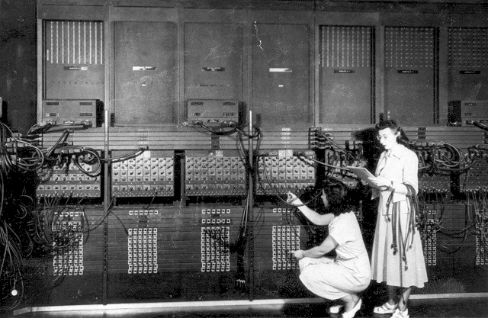
First Generation (1945-1955): Direct Input
Run one job at a time
Enter it into the computer (might require rewiring)
Run it
Record the results
Programming languages were unheard of
Assembly languages were not known
No reason for an OS
Eniac, 1945

Slide 4
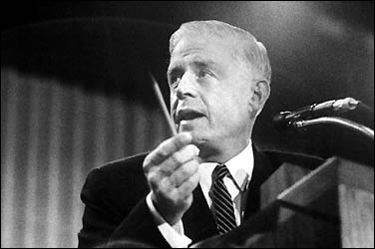
A Famous Quote
"I think there is a world market for maybe five computers."
Thomas Watson, Chairman of IBM - 1943

Slide 5
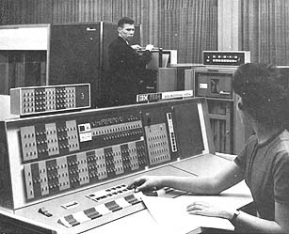
Second Generation (1955-1965): Batch Systems
Programs were written on paper in either FORTRAN or assembly
Programs encoded on punched cards
The card deck was taken down to the input room and handed to one of the operators
Programmer would come back later for results
IBM 7094/1401

Slide 6
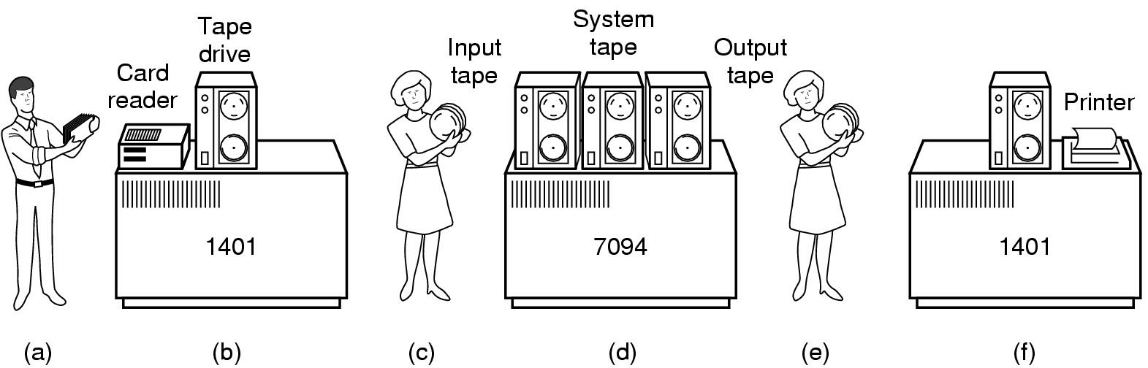
Second Generation (1955-1965): Batch Systems
The programmer is waiting for this:
Bring cards to 1401
Read cards onto input tape
Put input tape on 7094
Perform the computation, writing results to output tape
Put output tape on 1401, which prints output

Slide 7
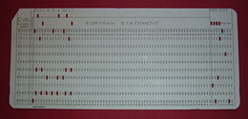
Programs on Punched Card
Z(1) = Y + X(1) //Fortran statement

Slide 8
Spooling
Eventually tape drives were replaced with disks
Disks enabled simultaneous peripheral operation on-line (spooling)
Computer overlapped entering punched cards to disk of one job with execution of another
Still only one job active at any given time
CPU often underutilized
Example: What if the job needs data from the disk?
Notes:
8

Slide 9
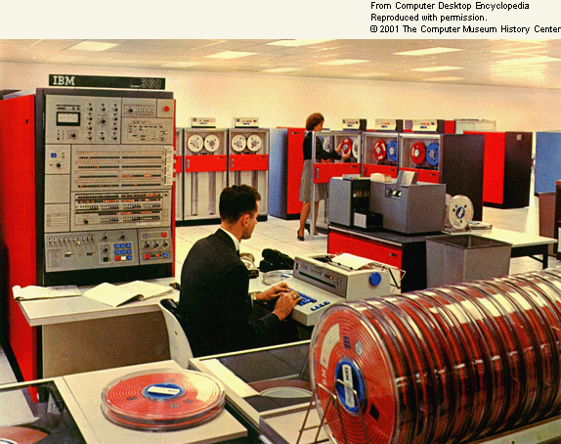
OS/360
A first example of an OS for this generation is IBM’s OS/360
Considered a landmark operating system

Slide 10
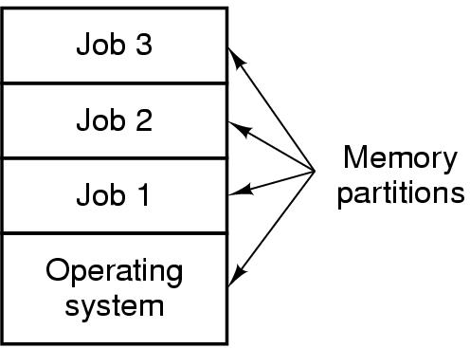
Third Generation: Multiprogramming (1965-1980)
Multiple jobs in memory
Protected from one another
Operating system protected from each job as well
Overlap I/O of one job with computing from another job
Notes:
10

Slide 11
Third Generation: Multiprogramming (1965-1980)
Multiprogramming allowed several jobs to be active at one time
Computer use got much cheaper and easier
These developments allowed for interactive use

Slide 12
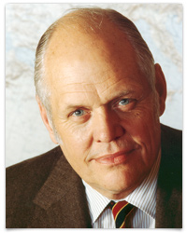
Yet Another Quote
“There is no reason anyone would want a computer in their home.“
Ken Olson, president, chairman and founder of Digital Equipment Corp. - 1977

Slide 13
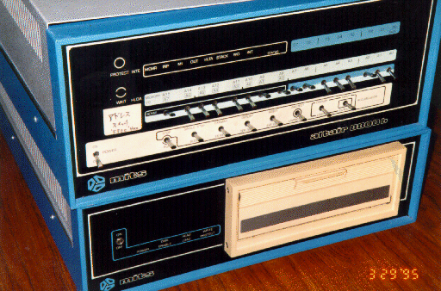
Fourth Generation (1980-) Personal Computers
Personal computing changed the computing industry
Intel came out with the 8080 in 1974
Lots of companies produced complete systems
The Control Program for Microcomputers (CP/M) from Digital Research was used
Altair 8080, 1975
256 bytes of memory
Enter data through one of toggle switches
on the front
Results were indicated by flashing
lights on the front panel

Slide 14
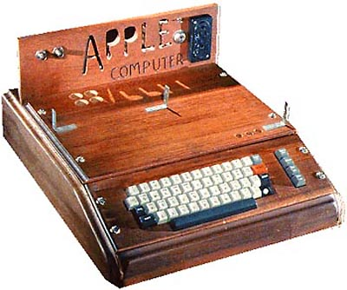
Fourth Generation (1980-) Personal Computers
Motorola produced an 8-bit microprocessor, the 6800.
Group of Motorola engineers left to form a new company to manufacture the 6502 after Motorola rejected it
CPU used in early systems including Apple I

Slide 15
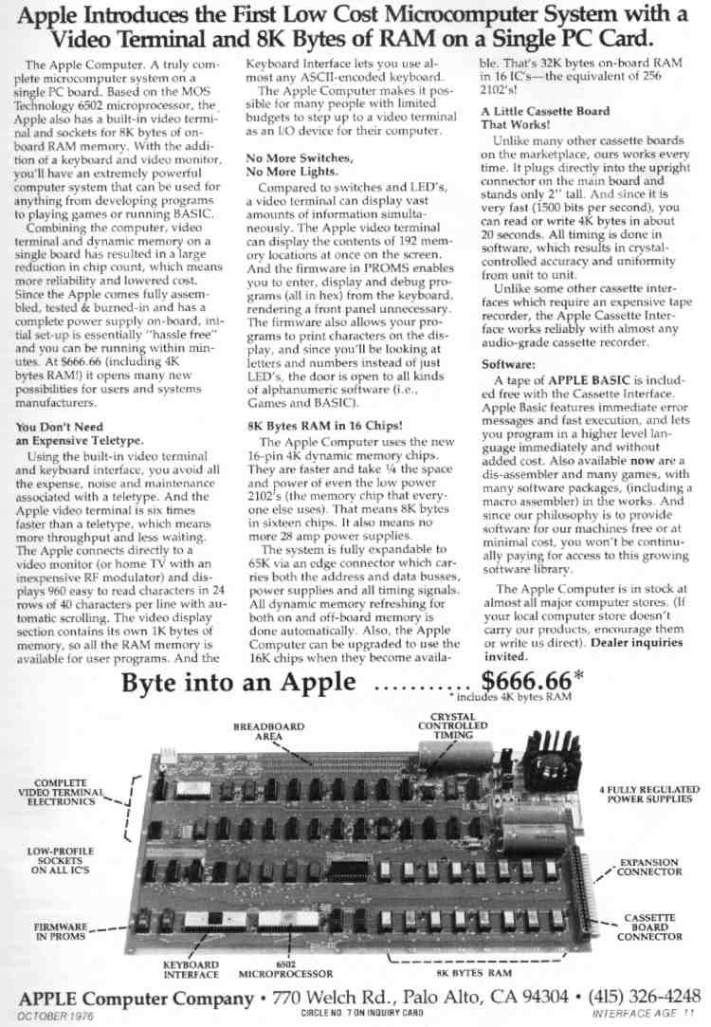
Apple 1 Ad

Slide 16
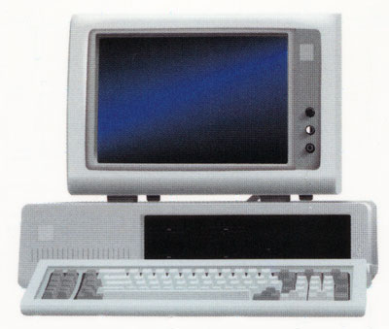
Fourth Generation (1980-) Personal Computers
Now came the 16-bit systems with Intel’s 8086
IBM designed the IBM PC around the 8088 (an 8086 on the inside with an 8 bit external data path)
IBM needed an OS for their PCs; CP/M behind schedule
Who did they turn to?
IBM PC, 1981
Retailed at $2880
64 kilobytes of RAM
Single-sided 160K 5.25 floppy drive

Slide 17
Famous Quote
“We don't see Windows as a long-term graphical interface for the masses.”
A Lotus Software Development official, while demonstrating a new DOS version - 1989

Slide 18
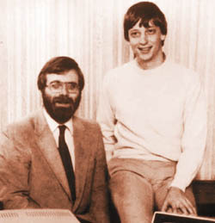
Fourth Generation (1980-) Personal Computers
Bill Gates suggested to IBM that they should look at CP/M (one of the the most successful OS for microcomputers at that time, by Gary Kildall)
The biggest mistake of all:
Kindall refused to sign a non-disclosure agreement
Notes:
18

Slide 19
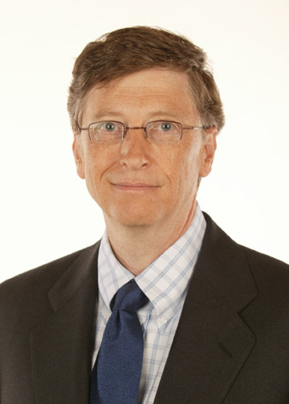
Fourth Generation (1980-) Personal Computers
IBM went back to Bill Gates
Gates offered an OS called DOS
DOS came from a company called Microsoft
Microsoft hired Bill Gates to improve it
The new OS was renamed MS-DOS
Notes:
19

Slide 20
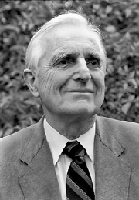
Fourth Generation (1980-) Personal Computers
Up to this point all operating systems were command line
Doug Englehart at Stanford invented the Graphical User Interface (GUI)

Slide 21
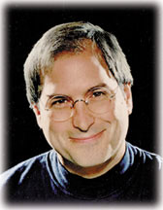
Fourth Generation (1980-) Personal Computers
Steve Jobs was also the co-founder of Pixar which has created very successful animated films: Toy Story ; A Bug's Life; Toy Story 2; Finding Nemo; Monsters.
Steve Jobs saw the possibility of a user-friendly PC
This led to the Apple Macintosh in 1984
Notes:
21

Slide 22
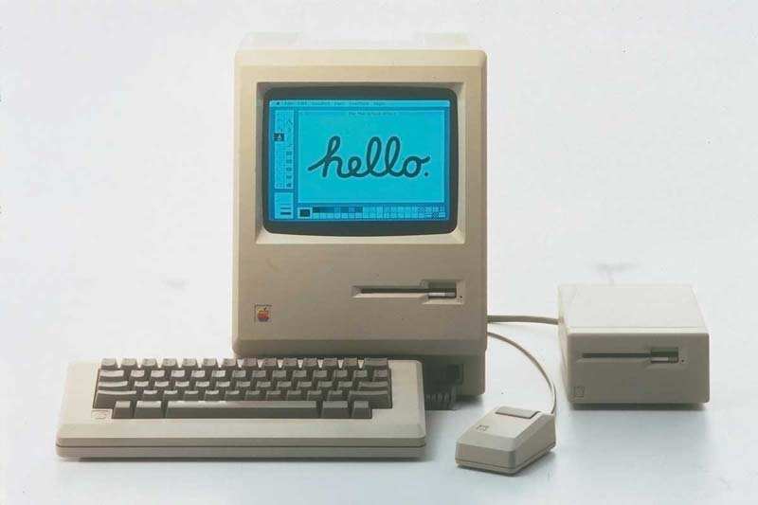
Fourth Generation (1980-) Personal Computers
Used Motorola’s 16-bit 68000
64 KB of ROM
Of course it had the first GUI
BTW, Apple only started using Intel processors in 2006

Slide 23
What about UNIX?
Let’s go back to the 60’s
MULTICS was the first large timesharing system developed jointly between MIT, General Electric (computing division eventually sold to Honeywell) and Bell Labs
MULTICS introduced many seminal ideas
But,…. OS was written in a language called PL/1
Not a lot of these got sold but they were very popular with those who bought
Last one was put out of commission in 2000
It was owned by the Canadian Department of National Defence

Slide 24
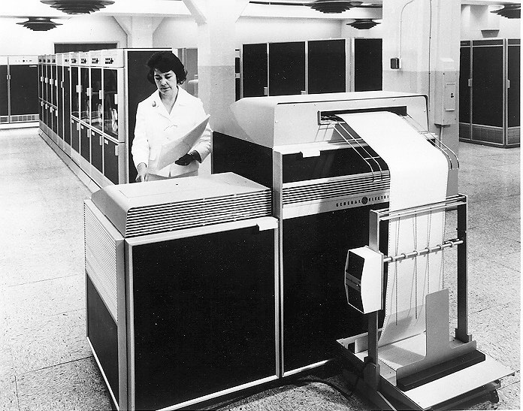
MULTICS

Slide 25
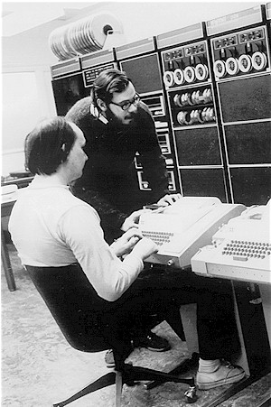
What about UNIX?
One of the computer scientists at Bell Labs who worked on MULTICS was Ken Thompson
He found a small PDP-7 minicomputer that no one was using
He decided to write a stripped-down, one-user version of MULTICS in the C programming language
This became UNIX.
This was open source which led to other versions: System V (AT&T) and BSD (Berkeley Software Distribution)

Slide 26
What about MINIX?
Eventually AT&T realized that UNIX was commercially viable
Unix, Version 7’s license prohibited the source code from being studied in courses
A computer scientist, Andrew Tanenbaum, was appalled
He created a new OS (using the C programming language) from scratch that would be compatible with UNIX but completely different on the inside
This was MINIX or mini-Unix; released in 1987
Better structured then UNIX
MINIX-2 released in 1997
MINIX-3 released in 2006

Slide 27
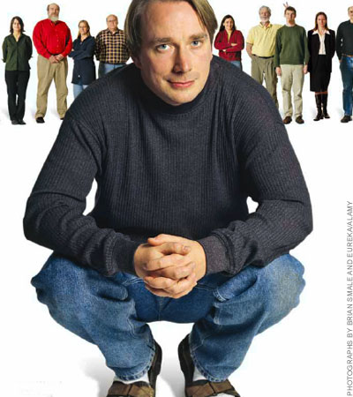
LINUX
After MINIX was released a USENET newsgroup (think of this as a chatroom), comp.os.minix was formed.
Quickly had 40,000 subscribers who wanted to add stuff
One was a Finnish student named Linus Torvalds

Slide 28
LINUX
Torvalds wanted to add features which led to other things
Eventually this led to his own OS called Linux (August 1991)
Linux is a notable success of the open source movement
Notes:
28

Slide 29
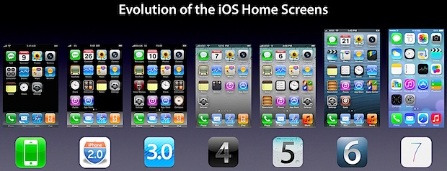
Today
Mobile Devices
http://osxdaily.com/2013/06/15/evolution-of-iphone-ios-home-screen/

Slide 30
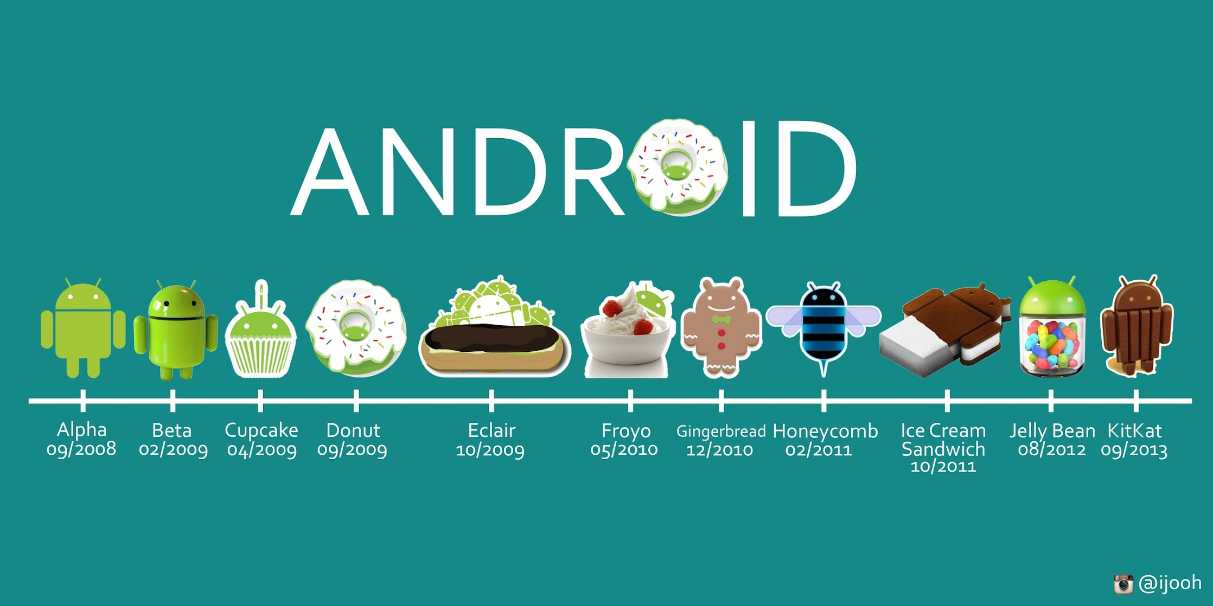
Today
Mobile Devices
http://sharein.org/wp-content/uploads/2015/01/android-nombres-postres.jpg

Slide 31
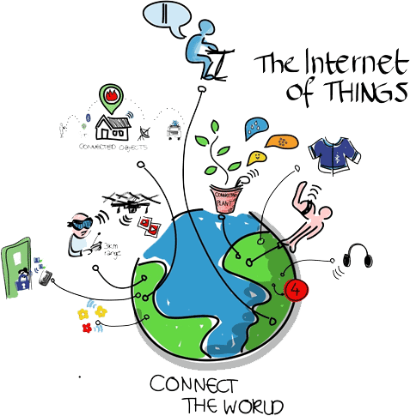
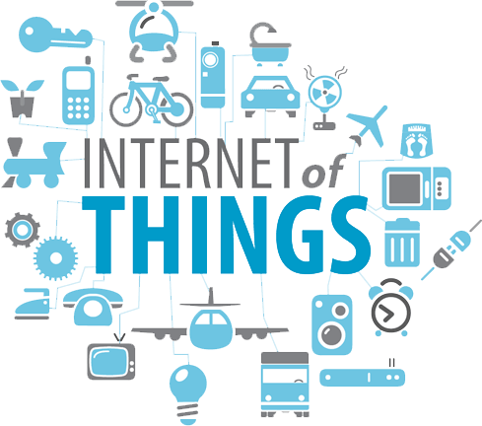
Today
Sensors – “Internet of Things”
Notes:
http://upload.wikimedia.org/wikipedia/commons/a/ab/Internet_of_Things.jpg

Slide 32
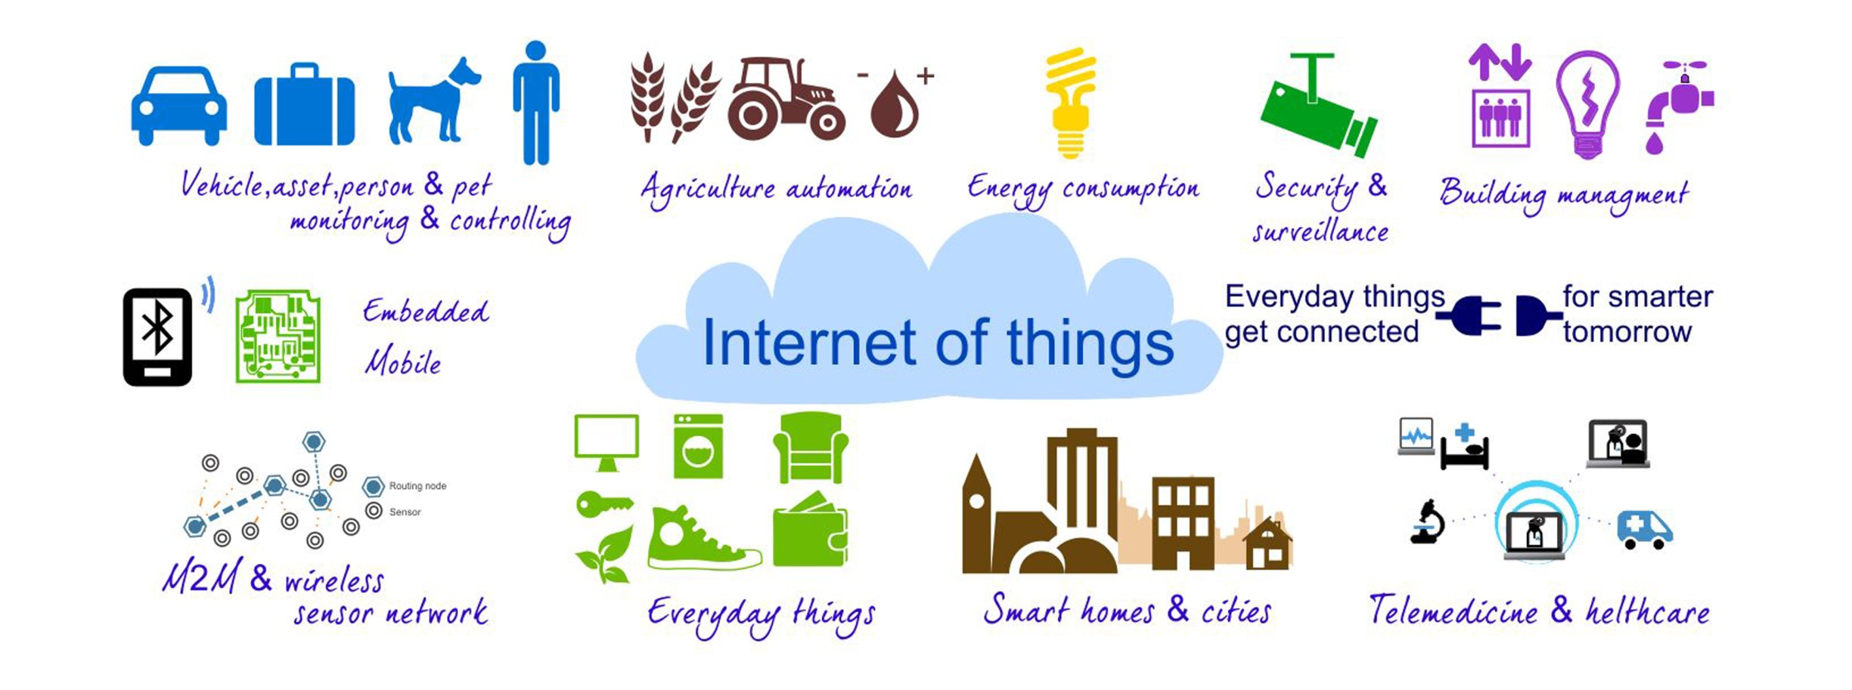
Notes:
http://www.janua.fr/wp-content/uploads/2014/12/internet-of-things.jpg

Slide 33
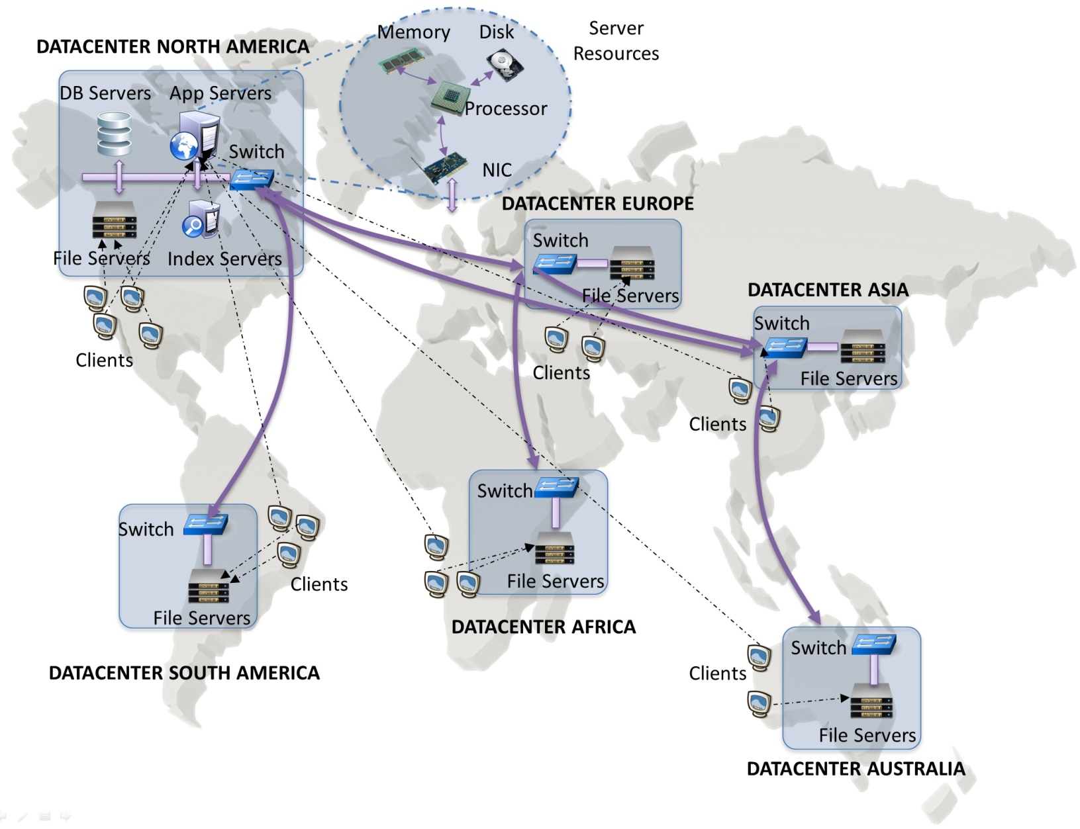
Today
Data Centres/Cloud

Slide 34
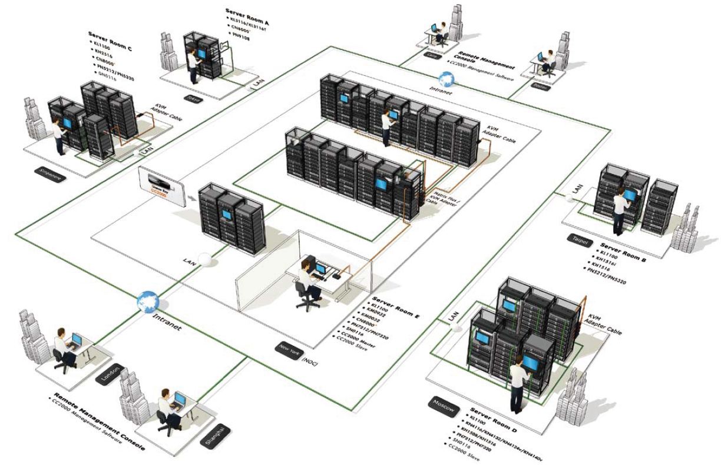

Slide 35
